Slide 1
Parallel and Perpendicular Lines
EQ – Describe the relationship between two lines that are parallel and two lines that are perpendicular.

Slide 2
Learning Objectives
Understand the relationship between parallel and perpendicular lines.

Slide 3

Parallel and Perpendicular Lines EQ – Describe the relationship between two lines that are parallel and two lines that are perpendicular.
Task:
What is the gradient and y-intercept for the following lines
$y=5x−2$
$2y=3x+4$
Solve and represent of a number line
$$\frac{x+2}{3}≤9$$
Solve the equation $\frac{x}{3}+2=\frac{1}{3}$
$\frac{1}{5}×−5=$

Slide 4

Inquiry
Parallel and Perpendicular Lines EQ – Describe the relationship between two lines that are parallel and two lines that are perpendicular.
Task:
1. Draw on the coordinate grid the following lines
$y=2x+3$
$y=2x+1$
$y=2x−2$
$y=2x$
2. What do you notice?

Slide 5

Inquiry
Parallel and Perpendicular Lines EQ – Describe the relationship between two lines that are parallel and two lines that are perpendicular.
Task:
1. Draw on the coordinate grid the following lines
$y=−2x+3$
$y=\frac{1}{2}x+1$
2. What do you notice?

Slide 6

Writing
Parallel and Perpendicular Lines EQ – Describe the relationship between two lines that are parallel and two lines that are perpendicular.
What are parallel and perpendicular lines?
Parallel lines go in the same direction and never meet
Perpendicular lines meet at right angles
Given the equations of two lines
$$y=m_{1}x+c y=m_{2}x+c$$
These two lines are parallel if the gradients are the same that is $m_{1}=m_{2}$
These two lines are perpendicular if the product of the gradients are $−1$
That is $m_{1}×m_{2}=−1$

Slide 7
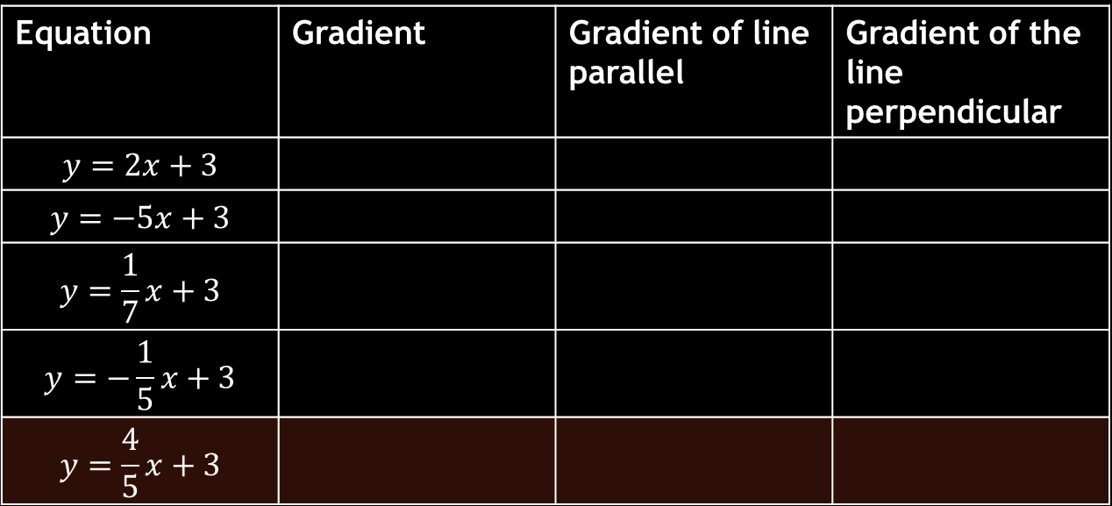
Writing
Parallel and Perpendicular Lines EQ – Describe the relationship between two lines that are parallel and two lines that are perpendicular.
Equation | Gradient | Gradient of line parallel | Gradient of the line perpendicular
$$y=2x+3$$
$$y=−5x+3$$
$$y=\frac{1}{7}x+3$$
$$y=−\frac{1}{5}x+3$$
$$y=\frac{4}{5}x+3$$

Slide 8

Writing
Parallel and Perpendicular Lines EQ – Describe the relationship between two lines that are parallel and two lines that are perpendicular.
Find the equation of a line parallel to $y=2x+3$and crosses the y-axis at $−2$.
2. Find the equation of a line perpendicular to $y=2x+3$and crosses the y-axis at $1$.

Slide 9
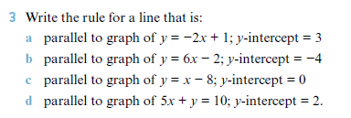
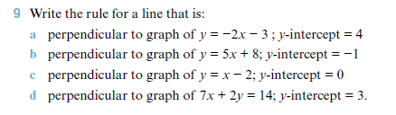
Writing
Parallel and Perpendicular Lines EQ – Describe the relationship between two lines that are parallel and two lines that are perpendicular.

